Slide 1
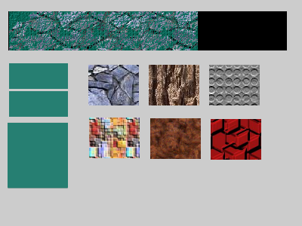
 | Base Template Developed by Eden Digital Sacrosanct school-wide baseline for Moodle Includes bare minimum required activities and guidance.
 | Departmental Template Developed by Eden Digital in consultation with department Builds upon base template and adds/adapts any other features departments deem universally desirable May include extra activities and guidance documentation specific to department.
 | Individual Moodle Courses Developed by academics/PSS using provided templates Eden Digital (as always) available for consultation on improvements.

