Slide 1
Whilst you are waiting…
Being a GTA at LSE
On Moodle | In the chat
Log in and go to tinyurl.com/LSEGTAW3 | Introduce yourself: tell us your name and the course(s) you are/ will be teaching.
Notes:
Put this at the top of your Zoom Whiteboard:
(You will not be able to display the above slide and the whiteboard)
On this Whiteboard: Tell us your name and the course(s) you will be teaching.
In the chat: Write down one question you have about teaching and learning (at LSE).

Slide 2
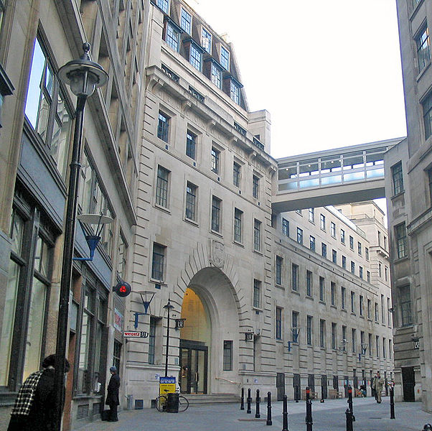
Being a GTA at LSE Workshop 3 Feedback and Assessment
Mark Baltovic, Sarah Crofton, Chris Doughty, Laura Hills, Kris Roger & Alex Spiers
@EdenLSE
This Photo by Unknown Author is licensed under CC BY-SA
Notes:
ALL
Mention departmental advising
Eden Digital
Support areas

Slide 3
Being a GTA at LSE
1 | Introduction to Teaching and Learning at LSE
2 | Planning and Designing your Teaching
3 | Feedback and Assessment
4 | Evaluating your Teaching

Slide 4
Activity: When has learning occurred?
How can we determine when learning has occurred?
How can we measure learning?
Notes:
Intro -- Assessment can only be effective if we are clear about what we want to assess. - Laura
Pair – Share
Discipline content, disciplinary skills, broader skills set
Think about introducing – directly or indirectly the notion of constructive alignment.
5mins
5mins

Slide 5
“Assessment defines for students what is important, what counts, how they will spend their time and how they will see themselves as learners. If you want to change student learning, then change the methods of assessment.”
Brown, Bull and Pendlebury (1997) Assessing Student Learning in Higher Education, p.6
“Assessment is a moral activity.
What we choose to assess and how shows quite starkly what we value.”
Knight, P. (1995) Assessment for Learning in Higher Education, p.13.
Notes:
Laura

Slide 6
Fundamental principles of assessment
Validity (accuracy) and reliability (consistency)
The process of assessment must be effective in enabling students to demonstrate their achievement of the intended learning outcomes’
Rigour, probity and fairness
Assessments should ensure that ‘all students are treated equitably, and that they are all given equivalent opportunities to demonstrate their achievement of the required standards.
QAA, 2012, p.6.
This Photo by Unknown Author is licensed under CC BY-SA
Notes:
Laura
The QAA (2011) identifies two fundamental principles of assessment. These are ‘validity and reliability’ and ‘rigour, probity and fairness’. Validity and reliability mean that ‘the process of assessment must be designed and carried out in such a way that it is effective in enabling students to demonstrate their achievement of the intended learning outcomes’ (QAA, 2012, p. 6). Rigour, probity and fairness means that assessment should ensure that ‘all students are treated equitably, and that they are all given equivalent opportunities to demonstrate their achievement of the required standards’ (QAA, 2012, p. 6).
Reliability – refers to the extent to which assessments are consistent. Just as we enjoy having reliable cars (cars that start every time we need them), we strive to have reliable, consistent instruments to measure student achievement.
Problem of self-marker reliability -- but really the issue is to whether teachers are being self-consistent.
Validity – i.e. Does what it says on the tin? Measures what we set out to measure rather than what is easy?
Validity refers to the accuracy of an assessment -- whether or not it measures what it is supposed to measure. Even if a test is reliable, it may not provide a valid measure.
Fairness – Avoiding bias? Level playing field? Sometimes so easy to mark on the basis of personality (eg class presentations). More difficult to say if we are being fair about ideas and ideologies than with more quantitative courses.
Self and peer review techniques
While you are marking, glance back at first one or two essays periodically.
Swap an essay or two with another GTA.
Double-blind marking (as at LSE and not usually in US schools).

Slide 7
Different types of assessment
Summative | Assessment of learning
Formative | Assessment for learning
Diagnostic | Assessment as learning
Notes:
Laura
Assessment OF learning (Summative assessment) = the use of a task or an activity to measure, record and report on a student's level of achievement in regards to specific learning expectations. Assessment of knowledge/skills/level of understanding
Assessment FOR learning (Formative assessment) = the use of a task or an activity for the purpose of determining student progress during a unit or block of instruction. Teachers are now afforded the chance to adjust classroom instruction based upon the needs of the students. Similarly, students are provided valuable feedback on their own learning. Test of knowledge/skills/ability feedback for learning review path
Assessment AS learning (continuous - self and peer assessment) = is the use of a task or an activity to allow students the opportunity to use assessment to further their own learning. Self and peer assessments allow students to reflect on their own learning and identify areas of strength and need. These tasks offer students the chance to set their own personal goals and advocate for their own learning. Grade of knowledge/skills/ability, certification/progress
And, in fact, using peer and self assessment can be a useful way to answer students’ desire for more feedback and thus to address some of negative NSS results. We will explore feedback in greater detail later on.
7

Slide 8
What forms of assessment are used in your course?
Type in the chat
Notes:
https://info.lse.ac.uk/staff/divisions/Eden-Centre/Resources-from-Eden/Creating-and-negotiating-a-principled-online-learning-space
5 min plenary - raise hands to get on the mic

Slide 9
Activity: The Great British Biscuit Bake-Off (1)
You are a judge for the Great British Biscuit Bake-Off.
Download the 'biscuit assignment paper' from Moodle.
In 50-100 words define what a 'good' biscuit is.
Based on your definition, select which five of the ‘biscuits’ in the Biscuit Gallery are indeed 'good'.
Once completed, upload the paper to Moodle.
This Photo by Unknown Author is licensed under CC BY-NC-ND
Notes:
Laura / Alex
Individual exercise
Share – demo upload a doc
Iink shared tinyurl.com/LSEGTAW3
10 mins

Slide 10
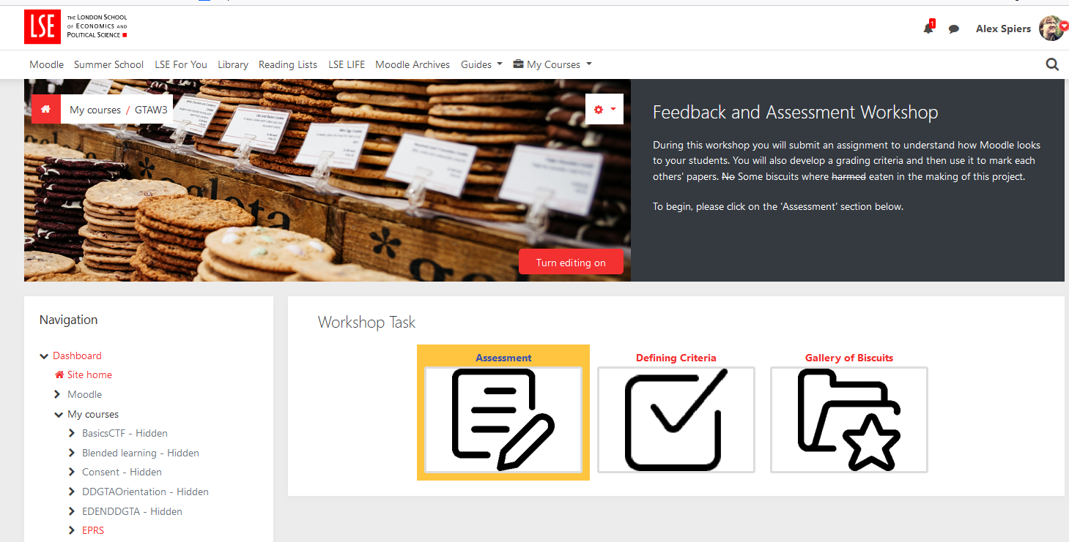
SELF ENROL tinyurl.com/LSEGTAW3
Notes:
Individual submission

Slide 11
Marking criteria and standards
A set of pre-defined statements outlining different standards of achievement normally expressed in relation to each of the stated assessment criteria.
A set of assessment criteria that explicitly communicate to students what knowledge and skills will be assessed.
Standards based assessment consists of two elements:
The grades awarded to students reflect the level of performance (or standard) they have achieved relative to the pre-defined standards.
Notes:
Laura

Slide 12
Marking criteria and standards - example
Criteria | Excellent | Pass | Fail
Reflected critically on the specificity of your discipline in terms of particular knowledge bases, skills and disciplinary attitudes | Good evidence of critical reflection on the specificity of discipline. | Some evidence of critical reflection on the specificity of discipline | No evidence of critical reflection. Primarily descriptive in approach.
Discussed the implications of specificity of your discipline for your approach to teaching and supporting your students’ learning | Broad-based discussion on implications of discipline on teaching and supporting learning. | Some discussion on implications of discipline on both teaching and supporting learning. | Limited discussion of implications of discipline on teaching and supporting learning.
Drawn on appropriate educational literature on teaching within the disciplines | Broad range of general and discipline specific literature cited, which is well integrated into reflection and discussion. | Some general and discipline specific literature cited, enough to meet minimum requirements. Evidence of integration into reflection and discussion. | Amount of literature cited less than minimum requirements. Little or no integration into reflection and discussion.
Notes:
Laura

Slide 13
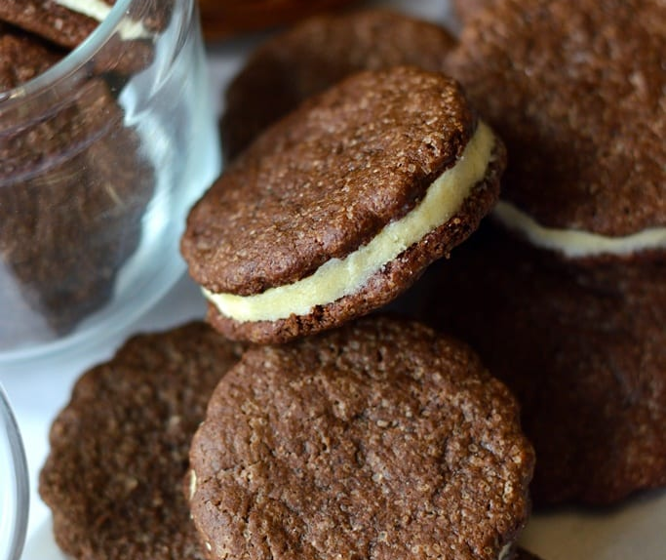
Activity: The Great British Biscuit Bake-Off (2)
In your group, reach a consensus on what a good biscuit is. With this in mind:
Identify three criteria for your biscuits
Identify three standards for each of the criteria: outstanding biscuits, good biscuits and poor biscuits.
Complete the Standard Based Assessment Criteria Board on Moodle.
This Photo by Unknown Author is licensed under CC BY-NC-ND
Notes:
LAURA introduce / ALEX - 15mins
Breakout groups in Zoom – matches Moodle
Zoom share demo of the activity
LAURA – explain standard for Good on BOARD then move either way
Read instructions -
Group Activity – break out room 5mins

Slide 14
What are the purposes of feedback?
This Photo by Unknown Author is licensed under CC BY-SA-NC
Notes:
Laura – whole class plenary
Break

Slide 15
Seven principles of good feedback practice
Helps clarify what good performance is (goals, criteria, expected standards)
Facilitates the development of self-assessment (reflection) in learning
Delivers high quality information to students about their learning
Encourages teacher and peer dialogue around learning
Encourages positive motivational beliefs and self-esteem
Provides opportunities to close the gap between current and desired performance
Provides information to teachers that can be used to help shape teaching
Source: (Nicol and McFarlane-Dick, 2006)
Further reading: Effective feedback Eden resource.
This Photo by Unknown Author is licensed under CC BY-SA
Notes:
Alex – feedback – audio – formative for GTA

Slide 16
This Photo by Unknown Author is licensed under CC BY
Notes:
Moodle Demo - assessment

Slide 17
Activity: The Great British Biscuit Bake-Off (3)
As judges, your task is now to mark the biscuit assignment and provide feedback to the competitors
Use the criteria and standards identified by your group to assess the definition and pictures of 'good biscuits' submitted as part of the biscuit assignment paper
Allocate one submission to each 'judge' in the group so that you each have access to someone else's submission
How far do the definition and selected pictures relate to your criteria?
In Moodle, provide some feedback (50-100 words) to your selected peer on the extent to which their submission meets the criteria identified
Notes:
LAURA ( describe activity) ALEX ( Demo) 20
Breakout Groups in Zoom
Marking in groups - review submission and feedback on one
Agree in groups who to mark
Criteria board open in another tab (ideally)

Slide 18
Activity: The Great British
Biscuit Bake-Off (4)
How easy was it to identify criteria and standards for the biscuits?
How easy was it to mark the biscuits in accordance with the criteria and standards?
How easy was it to provide feedback on the biscuits according to the grade awarded?
Notes:
Plenary LAURA 10mins

Slide 19
External resources
References
P. Knight Assessment for Learning in Higher Education (London: Kogan Page, 1995).
D.J. Nicol and D. McFarlane-Dick (2006). ‘Formative assessment and self-regulated learning: A model and seven principles of good feedback practice’ Studies in Higher Education, 31(2), 199–218.
Additional readings
JISC (2013), ‘Improving student assessment’
http://www.jisc.ac.uk/guides/improving-student-assessment
Jisc (2010) ‘Effective assessment in a digital age - a guide to technology-enhanced assessment and feedback’
https://www.jisc.ac.uk/media/documents/programmes/elearning/digiassass_eada.pdf
D.J. Nicol ‘From monologue to dialogue: improving written feedback processes in mass higher education’ Assessment & Evaluation In Higher Education 35:5, (2010).

Slide 20
What next?
Consult Eden Centre resources
Attend one of our Eden Centre Academic Development Atlas sessions
Contact your Eden Centre departmental advisers for bespoke discussions, guidance and expertise.
Contact Eden.digital@lse.ac.uk for learning technology-related questions.

